Slide 1
Intro to Psychology
Chapter 1

Slide 2


Intro to Psychology
What is psychology?
Learning induced neuroplasticity
http://youtu.be/TSu9HGnlMV0

Slide 3
Intro to Psychology
Psychology Goals
  Description
    Classification of mental disorders
  Understanding
    Diffusion of responsibility http://youtu.be/tGaJrgi_SpE
  Prediction
    Court-ordered evaluations
  Control
    Addiction recovery

Slide 4
Intro to Psychology
Perspectives on behavior
  Review Table 1.4 (page 29) with your neighbor and discuss which of the 7 contemporary ways you prefer to understand behavior
  Psychological charades
    Biological, evolutionary, behavioral, cognitive, psychodynamic, humanistic, sociocultural

Slide 5
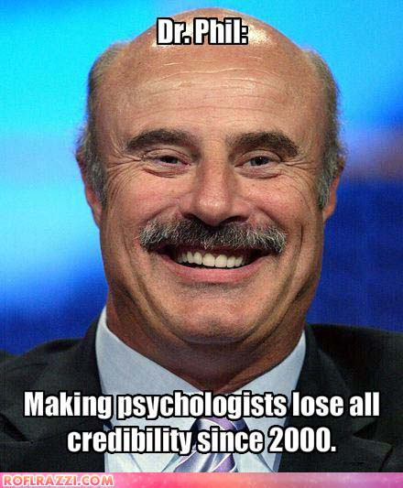
Intro to Psychology
Review Table 1.5 (page 32) about types of psychologists
  Applied vs. Basic research
  Questions you have for me?

Slide 6
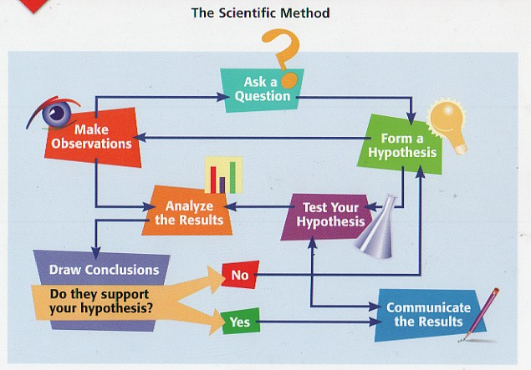
Intro to Psychology
Scientific method

Slide 7

Intro to Psychology
Psychology Research
  Experimental
    Cause and effect
    Subjects (control vs non-control)
    Random assignment
    Statistical significance (.05 level)
    Bias
Psychology Research
  Non-experimental
    Naturalist observation
    Correlational (-1 to +1, figure 1.9 page 41)
    Clinical method
    Survey method

